Slide 1
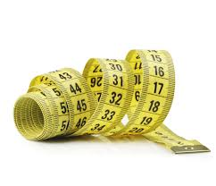
My Shape and Measurement Interactive Notebook
Name
Class
Teacher
Semester 1
Term 2
1

Slide 2
Contents
Glossary or Formula Page
Page
Date
Description
2
3

Slide 3
Tasks
24
7
30
Essential Question
Questions
Notes
Summary

Slide 4
Definition of a circle
A 2D shape
1 edge
No corners

Slide 5
24
7
30
Date
Circles
EQ – What do I need to know about circles?
What is a circle?
A 2D shape that has only one edge (or side) and no vertices (corners).
Circumference
The total measurement around the edge of the circle.
Diameter
The straight line measurement from one side to the other, passing through the centre of the circle.
Radius
The straight line measurement from the centre of the circle to the edge.
The radius is half the length of the diameter.
What is pi (π)?
π is used in the formulas to find the circumference and area of circles.
Its value is 3.14 (correct to 2dp). It is an irrational number (it has no equivalent fraction) and is a non terminating decimal.

Slide 6
Circumference and Radius.
diameter
radius
circumference
The circumference of a circle is the boundary of the circle.
A line segment drawn from the centre of a circle to the circumference is the radius. Every radius in a circle is equal in length.
A line segment drawn through the centre from one side of a circle to its opposite side is called the diameter. It is double the length of the radius.

Slide 7
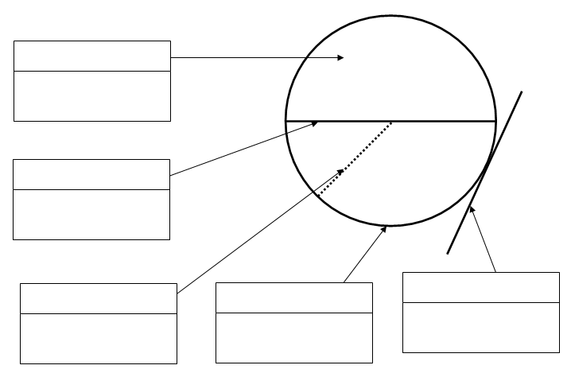
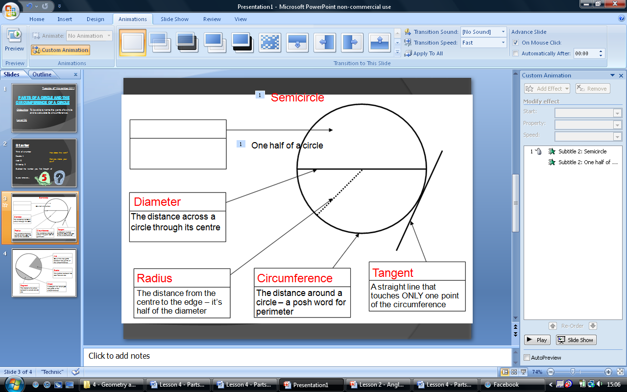
Other Parts of a Circle – For our Glossaries
Semicircle
One half of a circle
Diameter
The distance across a circle through its centre
Tangent
Radius
Circumference
A straight line that touches ONLY one point of the circumference
The distance from the centre to the edge – it’s half of the diameter
The distance around a circle – a posh word for perimeter

Slide 8
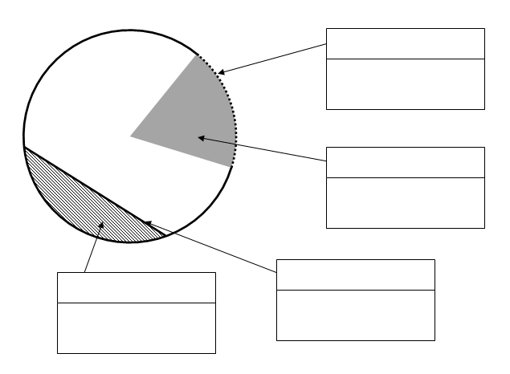
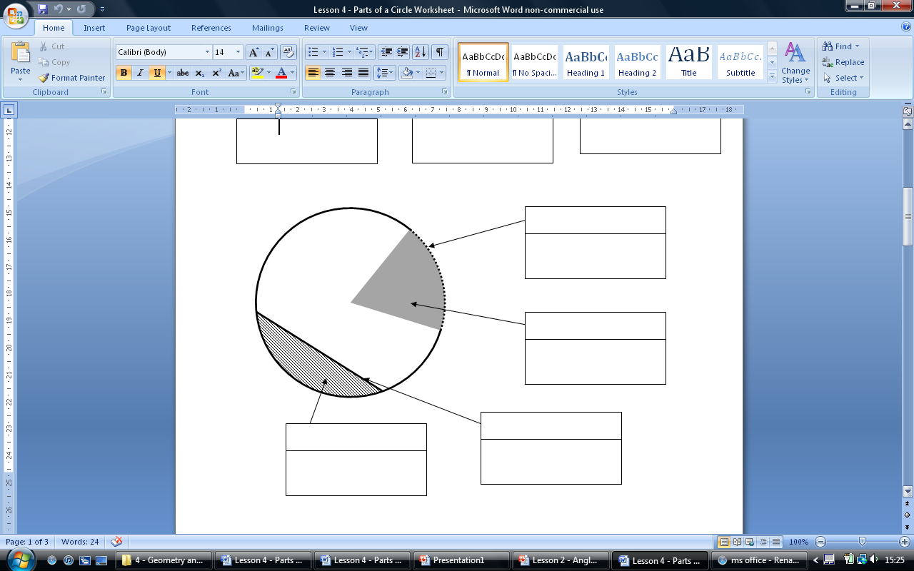
Other Parts of a Circle – For our Glossaries
Arc
One of the two parts between two points of the circumference
Sector
The portion between two radii and an arc
Chord
Segment
A straight line which joins two parts of the circumference
The region of a circle between a chord and an arc

Slide 9
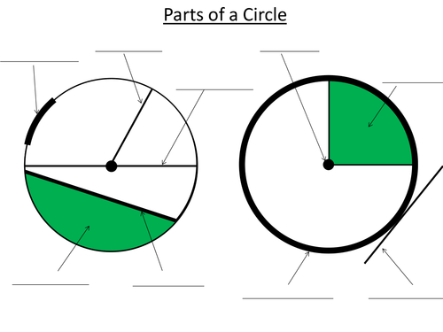
Complete Parts of a Circle Handout: Label them, then cut out and Paste
both in your INB’s

Slide 10
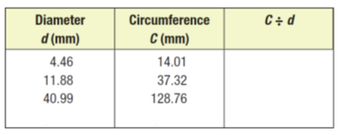
What did we learn from last lesson?
14.01÷ 4.46 = 3.14
37.32 ÷ 11.88 = 3.14
128.76 ÷ 40.99 = 3.14
When measured very, very accurately, they’re all equal to 3.14……..π!
C ÷ d = π Therefore… d x π = C

Slide 11
Words for your Glossary!
Circle
A 2D shape that has only one edge (or side) and no vertices (corners).
Circumference
The total measurement around the edge of the circle.
Diameter
The straight line measurement from one side to the other, passing through the centre of the circle.
Radius
The straight line measurement from the centre of the circle to the edge.
The radius is half the length of the diameter.
Pi (π)
π is used in the formulas to find the circumference and area of circles.
Its value is 3.14 (correct to 2dp). It is an irrational number (it has no equivalent fraction) and is a non terminating decimal.

Slide 12
24
7
30
Date
Circles
EQ – What do I need to know about circles?
How do I find the circumference of a circle?
Circumference = π x diameter
$$C=πd$$
Since the diameter is twice the length of the radius, it can also be found as:
Circumference = π x 2 x radius
$$C=2πr$$
*remember that multiplication can be done in any order

Slide 13
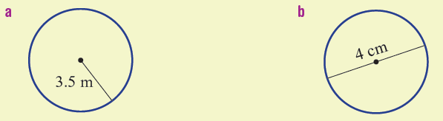
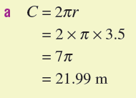
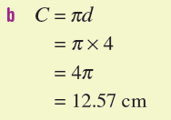
Let’s do some together

Slide 14
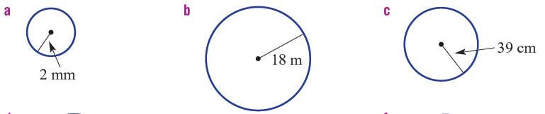
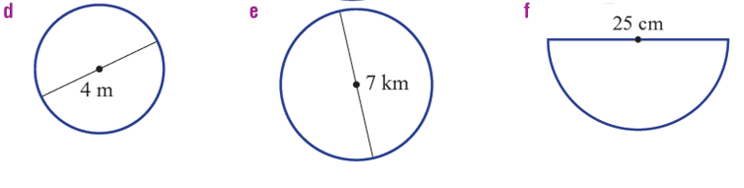
Now you try

Slide 15

Now you try

Slide 16
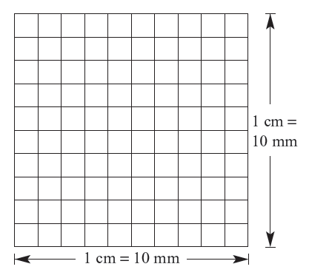
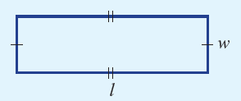

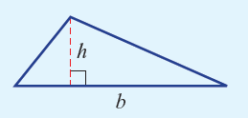

Reminder of Area
Area is the amount of space inside a shape and is measured in units squared (eg cm², m²)

Slide 17

24
7
30
Date
Circles
EQ – What do I need to know about circles?
How do I find the circumference of a circle?
Circumference = π x diameter
$$C=πd$$
Since the diameter is twice the length of the radius, it can also be found as:
Circumference = π x 2 x radius
$$C=2πr$$
*remember that multiplication can be done in any order
How do I find the area of a circle?
Area = π x ${radius}^{2}$
$$A=πr^{2}$$
*you must square the radius first.

Slide 18
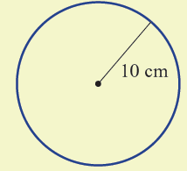
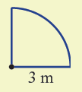
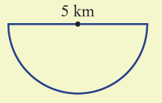
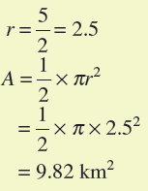

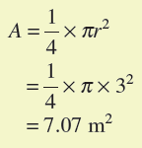
Let’s do some together

Slide 19
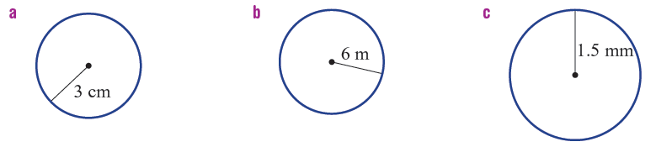
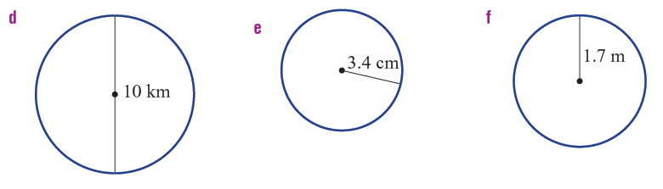
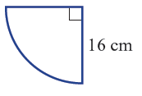
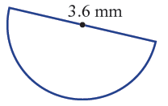
Now you try

Slide 20
Notes Review
24, 7 ,30
Date
Title
Essential question
Notes complete
Notes complete with colour and diagrams
Questions completed
Contents page filed in
Formula page filled in

Slide 21
Homework
Review your notes and write a summary answering the essential question.
Don’t forget your Mathspace work!

